Slide 1
Microbial physiology. Microbial metabolism. Enzymes. Nutrition. Bioenergetics. Bacterial growth and multiplication.
Dr.Ghaidaa Jassem Al-Ghizzawi

Slide 2
Microbial metabolism the Greek metabole, meaning change.
Metabolism - the sum of the biochemical reactions required for energy generation AND the use of energy to synthesize cell material from small molecules in the environment.

Slide 3
Why do we must know the metabolism of bacteria?
Because we want to know how to inhibit or
stop bacteria growth and want to control
their metabolism.

Slide 4
Metabolism
Two components:
Anabolism - biosynthesis
building complex molecules from simple ones
requires ENERGY (ATP)
Catabolism - degradation
breaking down complex molecules into simple ones
generates ENERGY (ATP)
3 Biochemical Mechanisms Utilized
Aerobic Respiration
Anaerobic Respiration
Fermentation

Slide 5
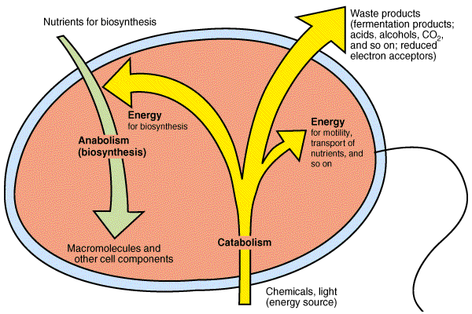

Slide 6
Catabolic reactions or sequences produce energy as ATP adenosine triphosphate , which can be utilized in anabolic reactions to build cell material from nutrients in the environment.

Slide 7
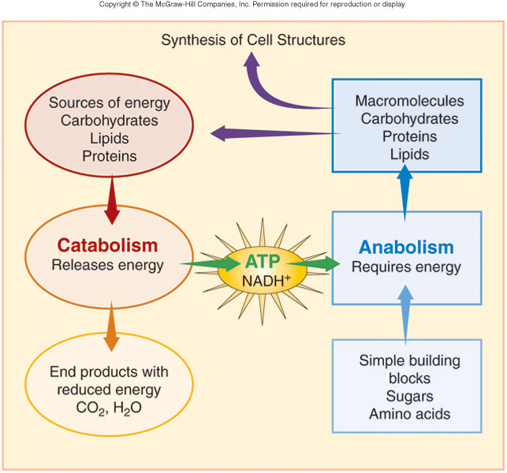

Slide 8
METABOLIC DIVERSITY
Bacterial metabolism is classified into nutritional groups on the basis of three major criteria:
1. Source of energy, used for growth
2. Source of carbon, and
3. Sours of electron donors used for growth.

Slide 9
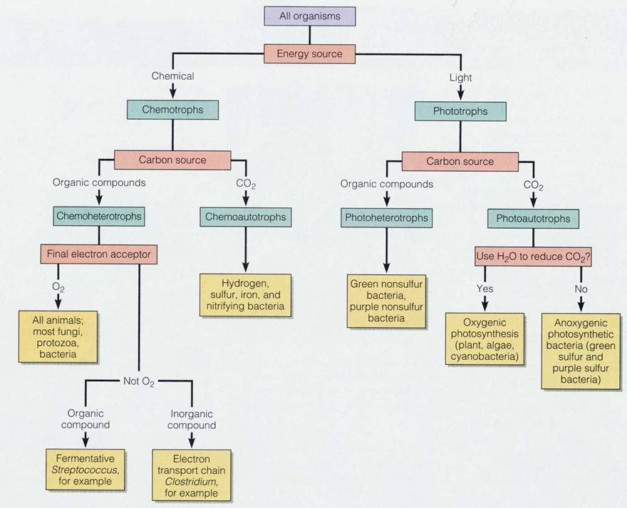

Slide 10
1. ENERGY SOURCE
a. Phototrophs —can use light energy
b. Chemotrophs —must obtain energy from oxidation-reduction of external chemical compounds

Slide 11
2. CARBON SOURCE
a. Autotrophs —can draw carbon from carbon dioxide
b. Heterotrophs —carbon from organic compounds
c. Mixotrophic – carbon is obtained from both organic compounds and by fixing carbon dioxide

Slide 12
These requirements can be combined:
1. Photoautotrophs - light energy, carbon from
2. Photoheterotrophs —light energy, carbon from organic compounds
3. Chemoautotrophs —energy from chemical compounds, carbon from CO2
4. Chemoheterotrophs —energy from chemical compounds, carbon from organic compounds

Slide 13
CHEMOHETEROTROPHS
Energy and carbon both come from organic compounds, and the same compound can provide both. Specifically, their energy source is electrons from hydrogen atoms in organic compounds.
Saprophytes—live on dead organic matter
Parasites—nutrients from a living host
This group (more precisely chemoorganoheterotrophic) includes most bacteria as well as all protozoa, fungi, and animals. All microbes of medical importance are included in this group.

Slide 14
Energy – capacity to do work or cause change
Endergonic reactions – consume energy
Exergonic reactions – release energy

Slide 15
Redox reactions
Always occur in pairs.
There is an electron donor and electron acceptor which constitute a redox pair.
Released energy can be captured to phosphorylate ADP or another compound.

Slide 16
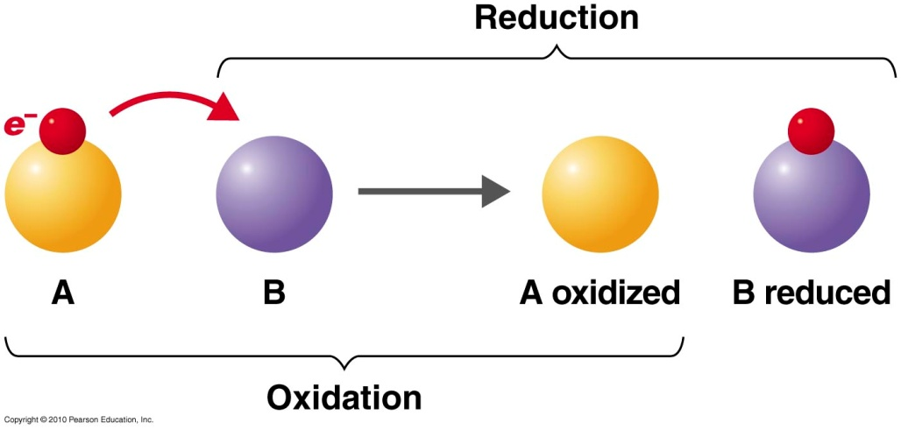
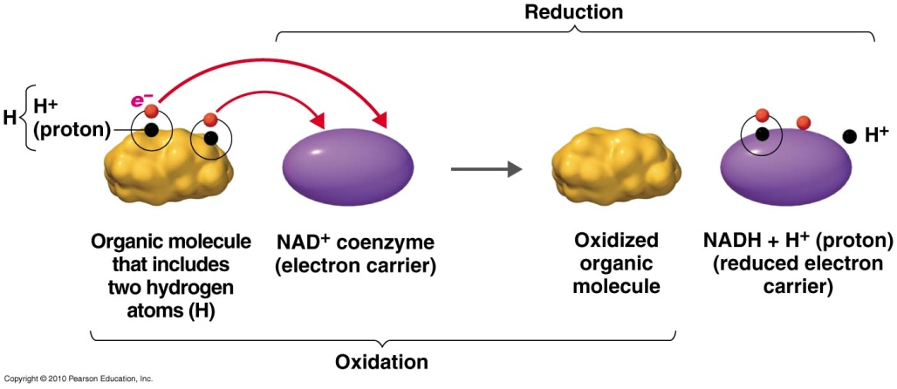
Oxidation-reduction reaction
Basic reaction
Biological reaction
: electron uptake
: electron removal
16

Slide 17
ATP
3 part molecule consisting of
adenine – a nitrogenous base
ribose – a 5-carbon sugar
3 phosphate groups
Removal of the terminal phosphate releases energy
Adenosine Tri Phosphate
ADP + energy + phosphate
ATP contains energy that can be easily released (high-energy or unstable energy bond)
Required for anabolic reactions

Slide 18
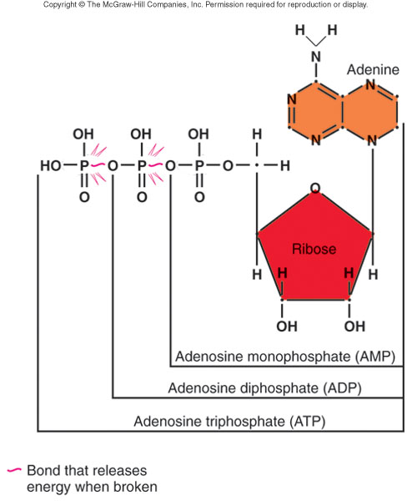
ATP

